Slide 1
TOPIC C:
CASE STUDY
LESSON C-3
INTELLIGENCE GATHERING

Slide 2
AGENDA
OSNIT
Passive OSNIT
Search Engine Dorking
Network Scanning & Mapping
Social Engineering
Active Scanning
NOTE!
Have a way to take notes and a way to write code available for this lesson

Slide 3

THE WARM UP QUESTION
How could publicly available information make a hospital easier to target?

Slide 4
THE WARM UP ANSWER
Employee Details can be public – social media
Technology used can be public – GitHub, HTML, etc.
Security Policies can be public – accountability and transparency

Slide 5
OSINT
OSNIT (short for Open-Source Intelligence) – utilizes tools and sources like
  Social Media
  Search Engines
  Forums
  Other internet facing resources
Goal is to gather actionable data about the hospital’s digital footprint
Hackers can use this to create a map of the hospital’s network presence and find weaknesses to exploit

Slide 6

PASSIVE OSINT
Passive OSINT is gathered by collecting data that’s already public
You don’t obtain or send any network traffic to the target organization’s systems
Using only publicly available information

Slide 7
PASSIVE OSINT
Employee Details – May be gathered through social media presence of staff
  Those in IT or administration are particularly valuable
Technology Usage – Insights into the hospital’s software derived from public sources
  Perhaps a public announcement of a new technology in a press release
Security Policies - Examining the hospital’s publicly available security policies
  Often these will be public so accountability is enforces and nobody is worried about how their data is used

Slide 8
PASSIVE OSINT
https://www.linkedin.com/search/results/people/?keywords=healthcare%20it%20admin&origin=GLOBAL_SEARCH_HEADER&page=2&spellCorrectionEnabled=false

Slide 9
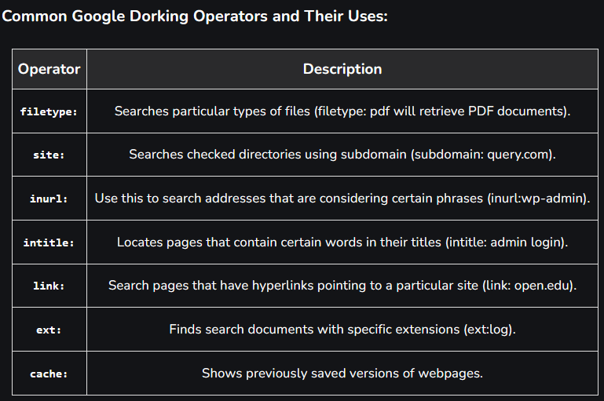
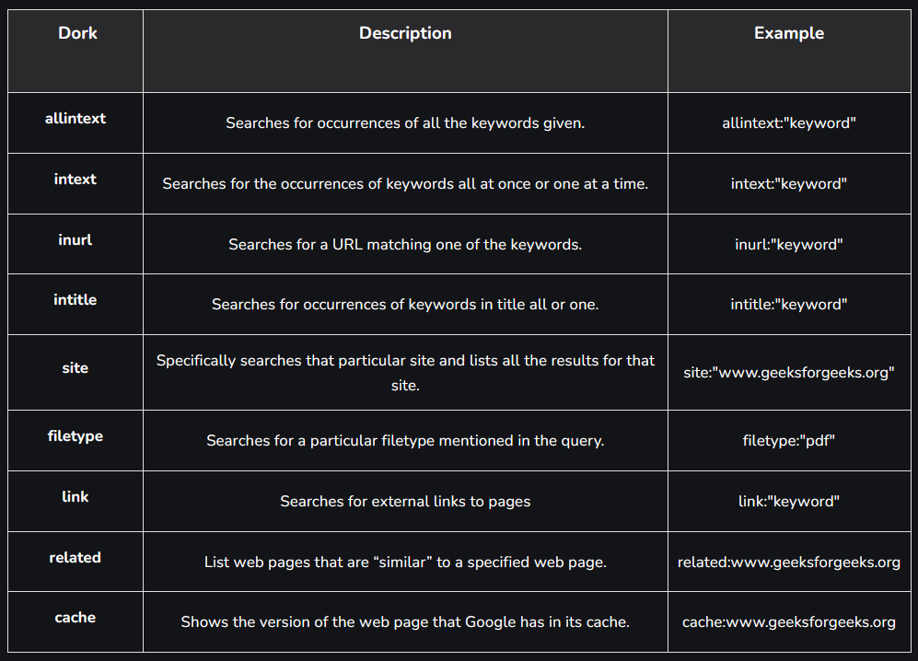
SEARCH ENGINE DORKING
One way to do this is to “Dork”
Dorking is a term for ‘advanced level’ Googling using commands to isolate websites, file formats, and others

Slide 10
SEARCH ENGINE DORKING
If organizations aren’t careful, dorking can be used to find:
  Public documents with sensitive info
  Leaked credentials (search for a leaked username)
  Unsecured/Misconfigured databases

Slide 11
VISHING/PRETEXTING
And of course, if we can contact somebody, we can scam them
For as smart as we think we are, many (especially older people) are vulnerable to social manipulation
  Vishing (phising over the phone, or voice phising): convince somebody in real time to do what you’d like
  Pretexting – creating a fabricated scenario to gain trust and manipulate into revealing sensitive info

Slide 12
ACTIVE SCANNING
Active Scanning – Interacting directly with the target networks to discover open ports, running services, or out of date programs
This must be done with the permission of the organization for ethical purposes
  We would need to ask the MTPH staff to be allowed to do an Active Scan
Much more in-depth than Passive OSINT

Slide 13
PORT SCANNING
Port Scanning – Listening over open ports on a network to determine what methods are accessible to connect to a network
Network maps can be created, showing how various devices are linked
  During this, IP addresses are catalogued for understanding of the network’s scope, and to attempt penetration testing with

Slide 14
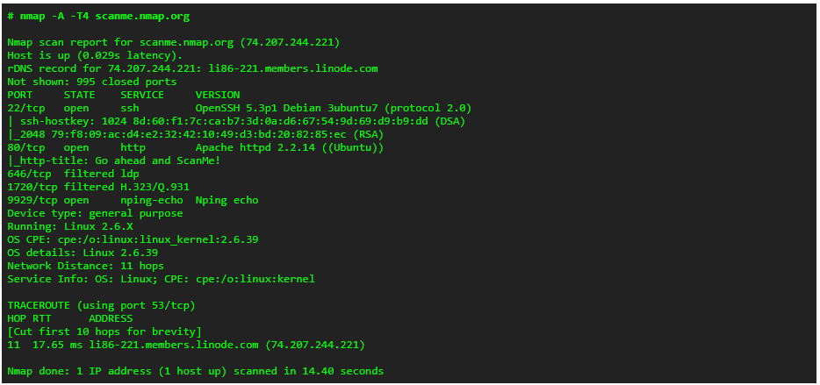
PORT SCANNING
I’d do a port scan myself, but the tech office would NOT be happy with me
We can call the command tracert <insert website here>
  Similar but not nearly the same

Slide 15
REFLECTION
Which testing approach do you believe is the most appropriate for MTPH?
Write out a short (paragraph with some bullet points) proposal to give to the MTPH admin about how you’d like to execute your penetration testing

Slide 16
REVIEW QUESTIONS
Explain three OSINT techniques the CyberHealth team could use on MTPH
Discuss one ethical and one operational limitation for each

